Slide 1


Slide 2

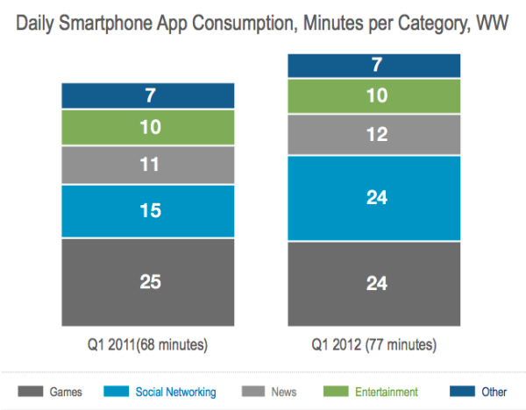



Games Dominate Mobile
We love video games
Games are the single most engaging piece of content our mobile and smartphones deliver to consumers all over the world.
Source: Flurry Analytics

Slide 3


But There’s a Problem…
Until now, mobile game distribution and monetization followed two narrow paths:
App stores: Where publishers will compete amongst 250,000+ games and invest large amounts of marketing dollars to make one of three lists
Top Paid
Top Grossing
Mobile Web: Where publishers are challenged with user retention and significant scale
Top Free

Slide 4





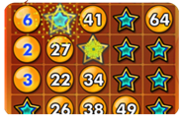
What is Game Drop?
An exclusive patent pending technology which allows any HTML5 game to be played within a native application via a publisher’s ad server; supporting all operating systems, one code base, and the games can carry ads as well
For the first time, any native app can be a distribution and monetization channel for mobile games, driving engagement and downloads

Slide 5
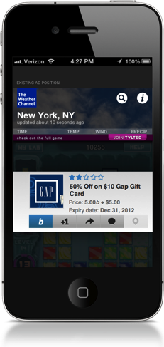
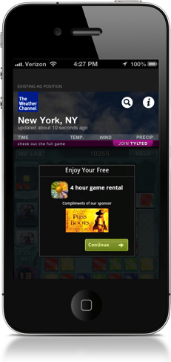
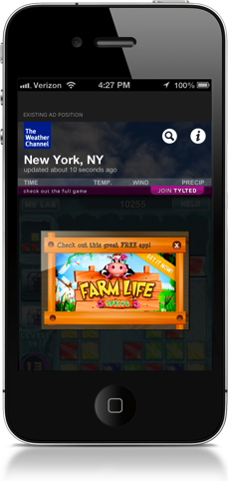
GameDrop Monetization
CPLead
CPM
CPInstall

Slide 6
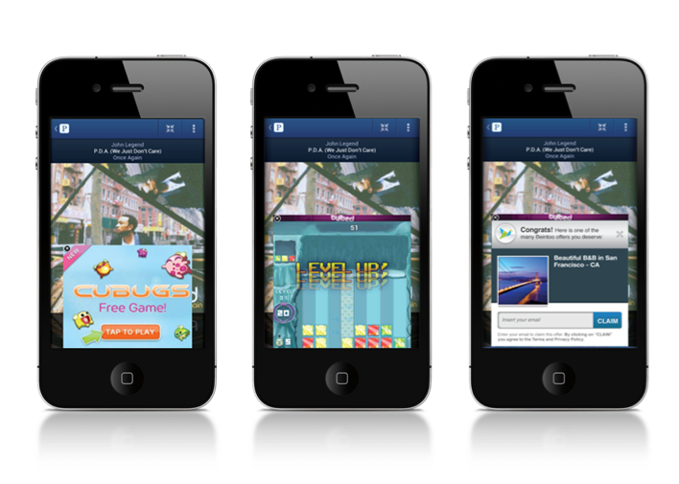

GameDrop Experience
Tylted ran and tested GameDrop™ with Pandora’s iOS and Android application.
300x250 ad unit
Expands to 350x320
Offers served
Consumers plays a game within the publisher Platform

Slide 7



Slide 8
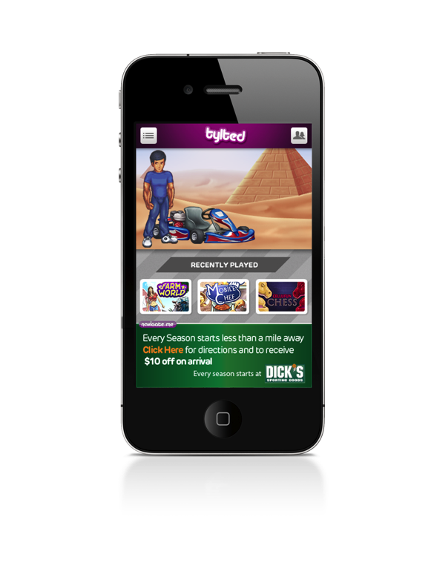
What is Navigate Me?
NavMe is a mobile ad unit that uses GPS direction and consumers’ location to navigate to a chosen destination. This patent pending technology automatically delivers an offer to consumers upon arrival.

Slide 9
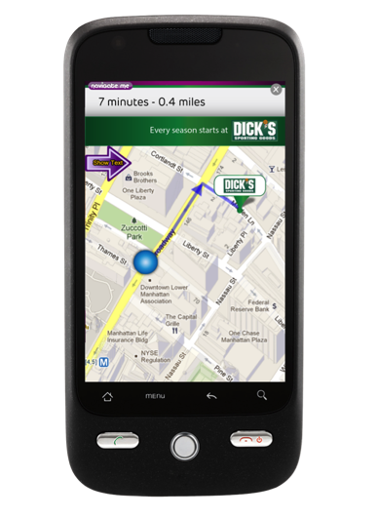
How Navigate Me Works
NavMe works by pulling in user location data that is married with Google Maps API.
This creates a list of desired locations relative to the consumer’s location. Users then select the preferred location and will receive real time directions in text and map form.
Once they are within a 3rd of a New York City block they will receive your offer to their mobile phone.

Slide 10
Key Advantages
Your consumer has arrived
When your consumer arrives at your location we trigger an action – special promotion or offer that will lead to a sale
Unique location based data
How far did they get?
Understand where along the location conversion funnel your consumers drops off
Where are my customers located?
Measure activity on the most granular level to find exactly where your consumers are located
How did they get there?
Device compatibility
Runs on any Smart Phone* including mobile web and applications
Rich Media
Navigate consumers from any publisher mobile web site or application
*Android, iPhone, Windows phones

Slide 11
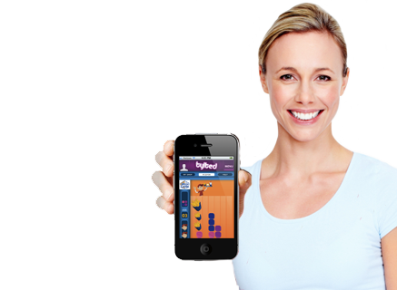

NavigateMe

Slide 12
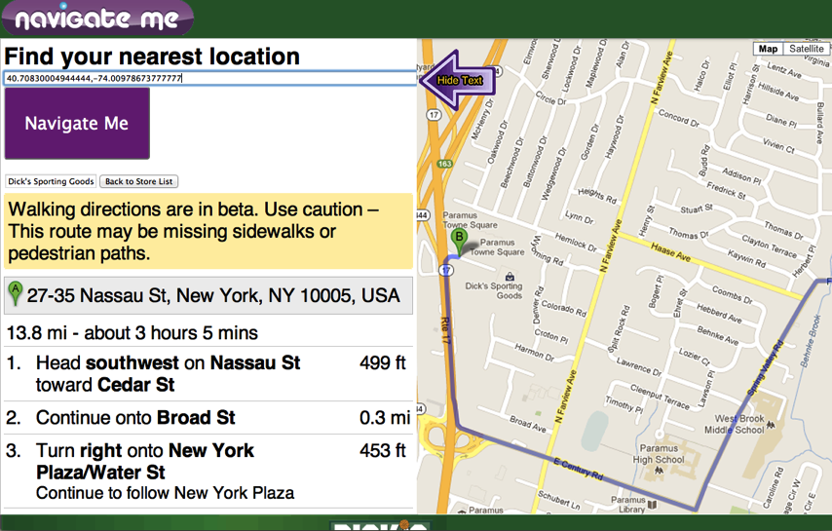
Directions

Slide 13
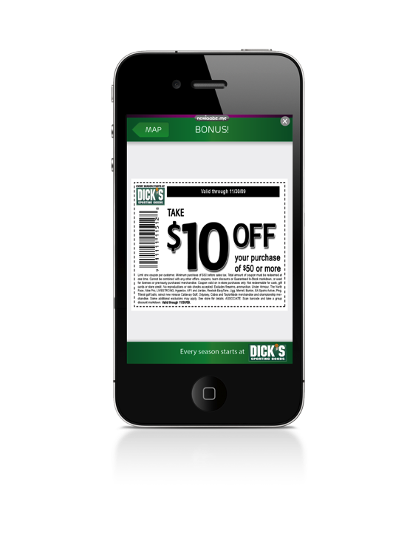
Arrival

